Slide 1

Diwali Sales Analysis
A project by Debasmita Paul

Slide 2

Data Analysis Project Steps
Create a Problem Statement.
Identify the data you want to analyze.
Explore and Clean the data.
Analyze the data to get useful insights.
Present the data in terms of reports or dashboards using visualization.

Slide 3
Business Problem
During the Diwali season, customer behavior changes significantly. The company wants to understand purchasing patterns across customer segments, regions, and product categories. The goal is to use these insights to optimize marketing strategies and boost sales in future festive campaigns.

Slide 4
Objective of the Analysis
Identify key customer segments based on gender, age group, and occupation that contribute the most to sales during the Diwali season.
Examine state-wise and zone-wise sales performance to determine high-potential geographic regions.
Analyze product category preferences to understand which products drive the highest sales during Diwali.
Provide data-driven recommendations to optimize marketing campaigns, target high-value customers, and increase sales during future festive seasons.

Slide 5
Research Questions
What is the gender distribution of customers?
Which age group spends the most during Diwali sales?
How does customer gender influence total spending during the Diwali sales period?
How do different age groups and genders contribute to customer demographics and sales during the Diwali sales period?
Which age group spends the most during Diwali sales?
Which states have the highest number of orders during Diwali?
Which states have the highest contribution to total sales during the Diwali season?
What is the distribution of customers based on their marital status?
How do marital status and gender influence total sales?
Which occupational groups have the highest representation among customers?
Which occupations contribute the most to total sales?
Which product categories attract the highest number of customers?
Which product categories generate the highest total sales revenue?
Which products achieved the highest sales volumes during the Diwali season?

Slide 6
Dataset Overview
User_ID: Unique identifier assigned to each customer. Cust_name: Name of the customer. Product_ID: Unique identifier assigned to each purchased product. Gender: Gender of the customer (Male/Female). Age Group: Age category of the customer (e.g., 0-17, 18-25, 26-35, etc.). Age: Exact age of the customer in years. Marital_Status: Marital status of the customer (Married/Unmarried). State: State from which the customer made the purchase. Zone: Geographical zone associated with the state. Occupation: Occupation of the customer. Product_Category: Category of the product purchased. Orders: Number of orders placed by the customer. Amount: Total amount spent by the customer.

Slide 7
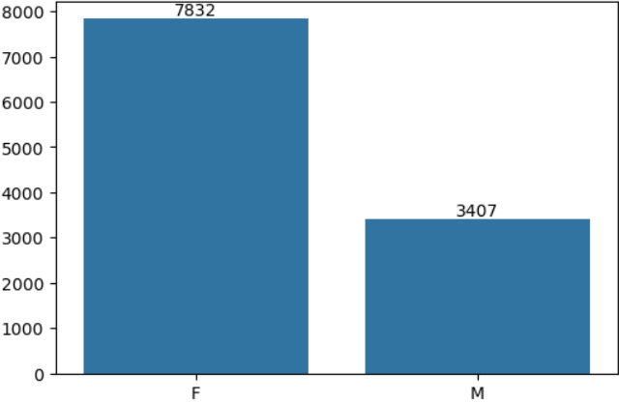
Analysis and Findings
Gender Distribution of Customers
This bar chart represents the distribution of customers based on gender during Diwali sales. It shows that female customers account for a significantly higher number of purchases (7832) compared to male customers (3407).The data suggests that women are more active shoppers during the Diwali season, contributing to a larger share of sales.

Slide 8
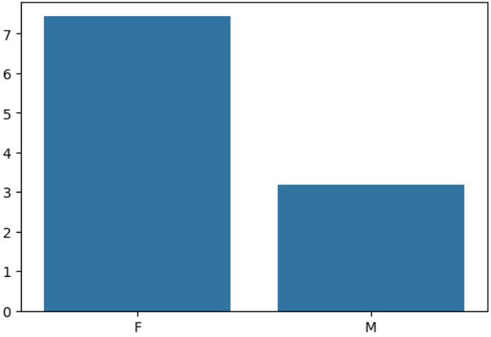
Total Amount Spent by Gender
This bar chart represents the total purchase amount spent by each gender during the Diwali sales period. Female customers spent a significantly higher total amount (over ₹7 crore) compared to male customers (around ₹3 crore).This suggests that women are not only more frequent buyers but also tend to spend more per transaction or overall, making them the key contributors to Diwali sales revenue.

Slide 9
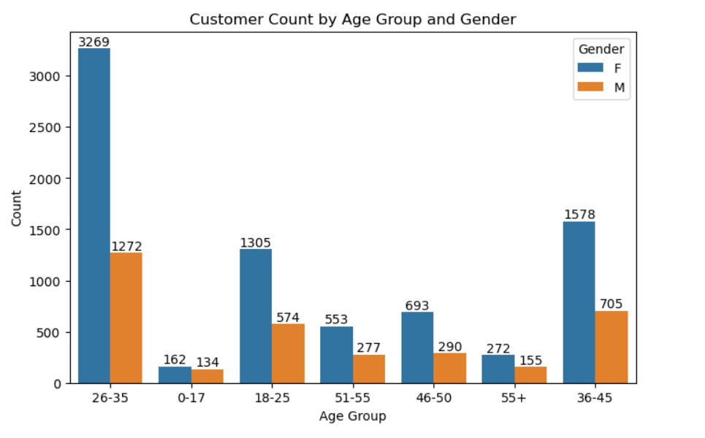
Customer Demographics by Age Group and Gender
This chart shows the distribution of customers across different age groups segmented by gender. The 26-35 age group has the highest customer count, with female customers (3269) outnumbering males (1272). Other significant segments include females aged 36-45 and 18-25, indicating that young to middle-aged women are the most active shoppers during Diwali. It suggests that there is a strong sales potential in Uttar Pradesh, Maharashtra, and Karnataka, which can be further leveraged through targeted marketing and customer retention strategies.

Slide 10
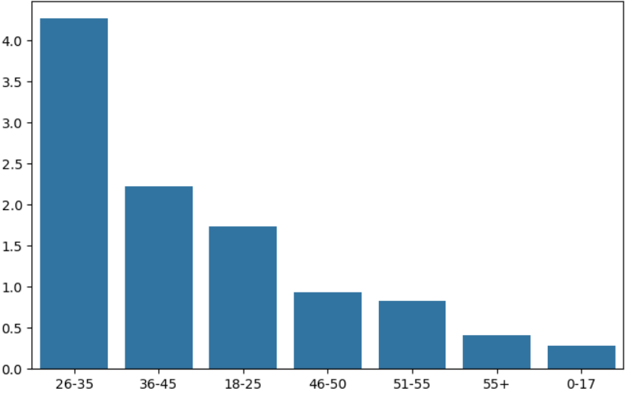
Total Amount Spent by Age Group
The chart shows that customers aged 26-35 are the highest spenders, contributing over 40 million in sales. This is followed by the 36-45 and 18-25 age groups, indicating that young and middle-aged adults are key contributors to sales. Spending significantly decreases in older (46+) and younger (0-17) age groups. It suggests that 26-35 age group is the most valuable customer segment during Diwali sales, as they contribute the highest total spending.

Slide 11
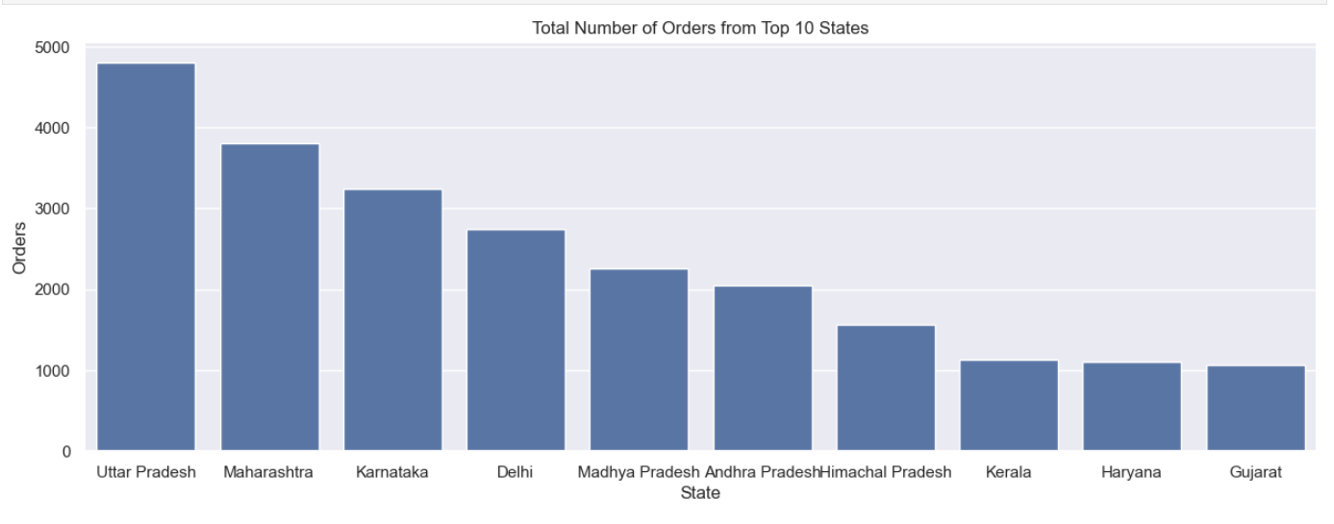
Top Performing States Driving Diwali Sales
The bar chart shows the Total Number of Orders from the Top 10 States during Diwali. Uttar Pradesh leads with the highest number of orders, followed by Maharashtra and Karnataka. Northern and Western states dominate the top positions, indicating a strong consumer demand in these regions. It suggests that Uttar Pradesh, Maharashtra, and Karnataka are the top-performing states in terms of Diwali orders. This indicates a higher consumer demand and purchasing power in these regions during the festive season.

Slide 12
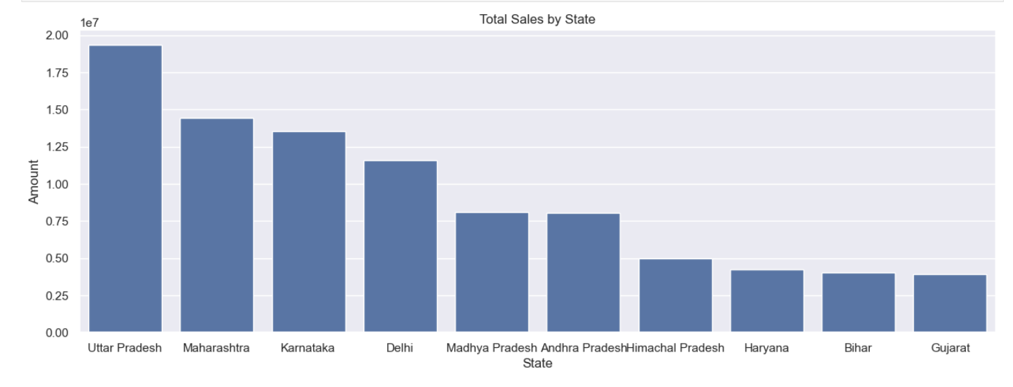
State-wise Contribution to Total Sales During Diwali
The bar chart presents the total sales across various Indian states. Uttar Pradesh leads significantly with the highest sales figures, followed by Maharashtra and Karnataka. These three states contribute a major portion of the overall sales. States like Delhi, Madhya Pradesh, and Andhra Pradesh show moderate sales, while Himachal Pradesh, Haryana, Bihar, and Gujarat are at the lower end in terms of sales contribution.

Slide 13
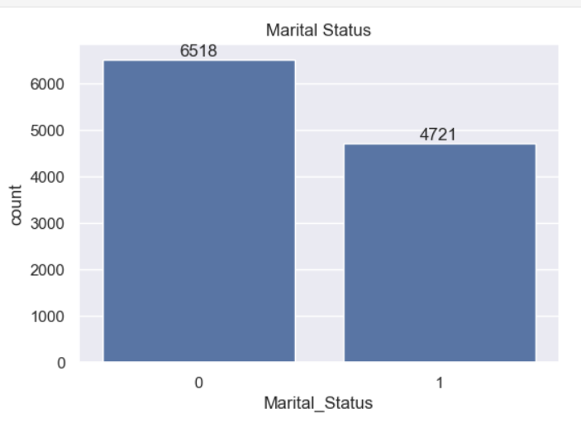
Customer Distribution by Marital Status
The bar chart illustrates the distribution of customers categorized by their marital status. A higher proportion of customers, 6518, are unmarried (denoted by 0), compared to 4721 married customers (denoted by 1). This indicates that the unmarried segment forms the majority of the customer base. It suggests that marketing strategies could be tailored more towards unmarried individuals, as they represent a larger portion of the customer demographic.

Slide 14
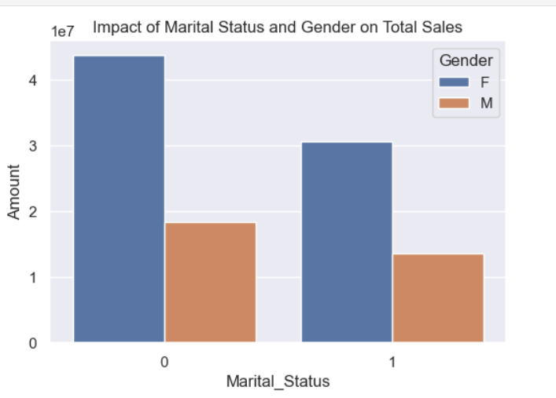
Impact of Marital Status and Gender on Total Sales
The bar chart shows that unmarried females (Marital_Status 0, Gender F) contribute the highest to total sales, followed by married females. Males contribute comparatively less in both marital status categories. It suggests that businesses should focus more on targeting female customers, particularly those who are unmarried, to maximize sales opportunities.

Slide 15
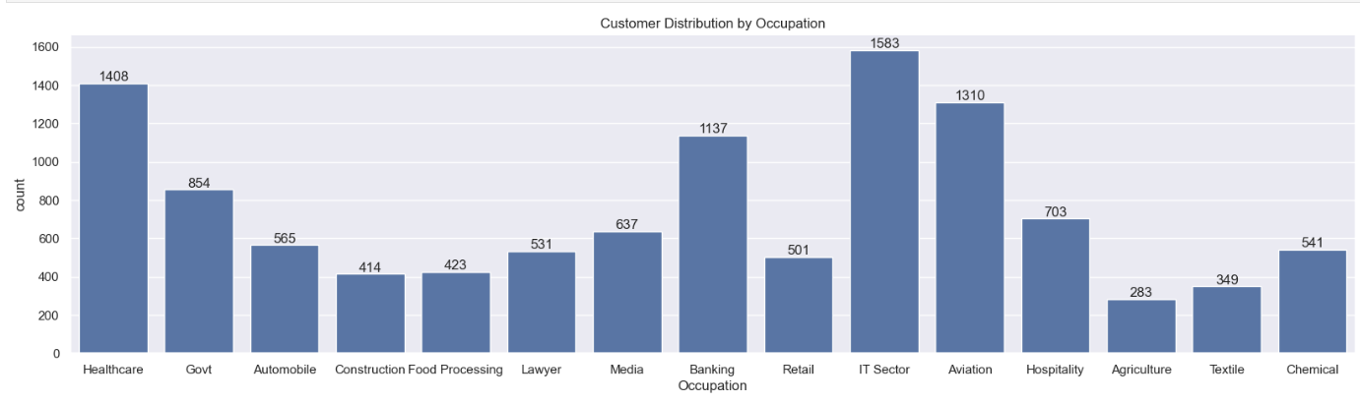
Customer Distribution by Occupation
The bar chart reveals that the IT Sector has the highest customer count (1583), followed by Healthcare (1408) and Aviation (1310). Occupations like Agriculture, Textile, and Construction show significantly lower customer counts. It suggests that marketing strategies could prioritize the IT, Healthcare, and Aviation sectors to target a larger customer base effectively.

Slide 16
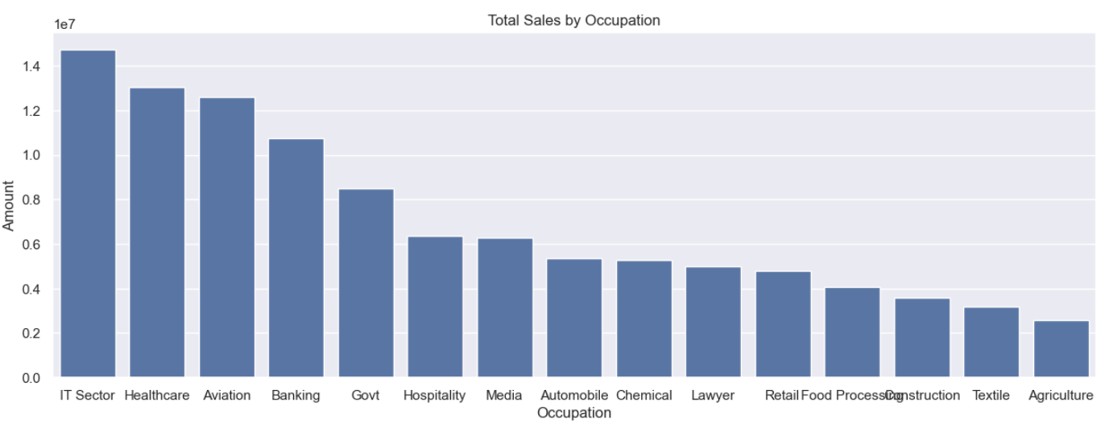
Total Sales by Occupation
The bar chart shows that the IT Sector leads in total sales, followed by Healthcare and Aviation. Occupations like Agriculture, Textile, and Construction contribute the least. This suggests a strong correlation between professional sectors and higher purchasing power, with IT and Healthcare being key drivers of revenue.

Slide 17
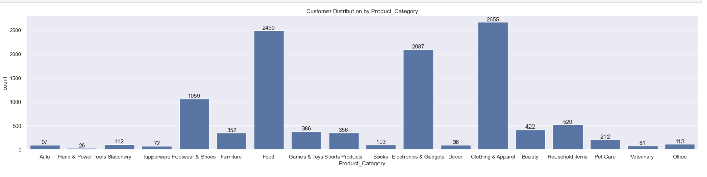
Customer Distribution by Product Category
The chart shows that Clothing & Apparel and Food categories have the highest customer counts, followed by Electronics & Gadgets. Categories like Hand & Power Tools, Veterinary, and Decor have the lowest customer engagement. This indicates that everyday essentials and technology-related products have a broader customer appeal.

Slide 18
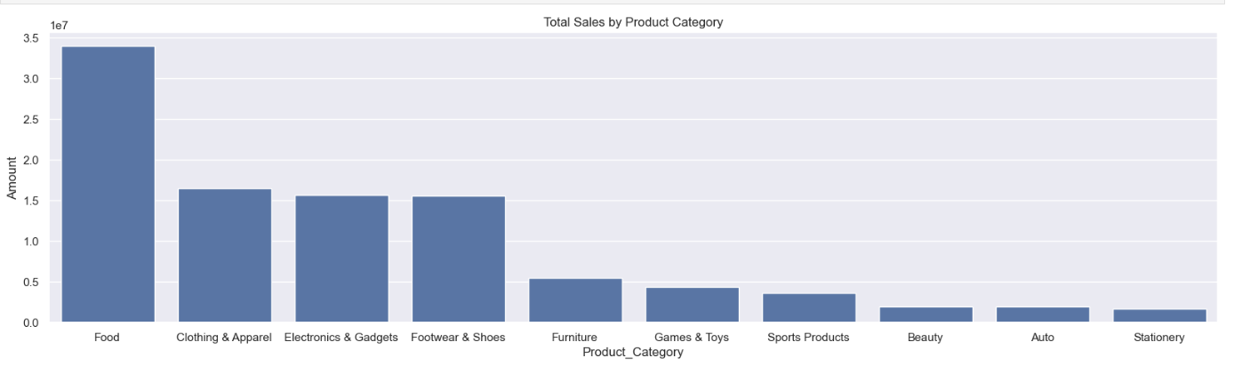
Total Sales by Product Category
The chart shows that the Food category leads in total sales, significantly surpassing all other categories. Clothing & Apparel, Electronics & Gadgets, and Footwear & Shoes follow with moderate sales figures. Categories like Beauty, Auto, and Stationery contribute the least to total sales revenue. This indicates that essential and frequently purchased items like food drive the highest revenue streams.

Slide 19
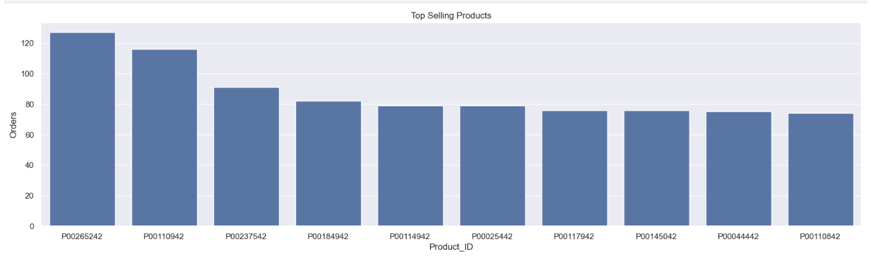
Top-Selling Products During Diwali Sales
The chart highlights that products with IDs P00265242, P00110942, and P00237542 recorded the highest number of orders during the Diwali sales period. It suggests that businesses should focus on stocking and promoting products that are traditionally in high demand during Diwali to maximize sales opportunities during the festive season.

Slide 20
Conclusion
The Diwali Sales Analysis provided valuable insights into customer demographics, regional performance, and product preferences during the festive season. By analyzing customer purchase behavior, we identified key customer segments, top-selling products, and high-performing regions. These findings can help businesses optimize their marketing strategies, inventory management, and customer targeting for future Diwali sales campaigns.

Slide 21
Key Insights
Male customers contributed a larger share of total sales compared to females.
The 26-35 age group was the most active and highest-spending demographic.
Married individuals contributed more to total sales than unmarried ones.
Uttar Pradesh, Maharashtra, and Karnataka recorded the highest sales. North and West zones showed strong sales performance.
Products with Product_IDs like P00265242, P00110942, and P00237542 were best sellers, indicating customer preference for specific product categories.
Categories like Clothing, Electronics, and Home Appliances were among the most popular and profitable.
Higher spending was observed among male customers aged 26-35, particularly those who are married.
Occupations such as IT professionals and executives showed higher average order values.

Slide 22
Recommendations
Focus marketing efforts on male customers aged 26-35, as they are the highest spenders.
Create personalized campaigns for married customers, offering exclusive Diwali deals.
Invest in marketing and logistics in high-performing states like Uttar Pradesh and Maharashtra to maximize revenue.
Offer region-specific products and promotions, considering local preferences.
Stock up on top-selling products before Diwali and offer bundle deals to increase basket size.
Launch new product lines in popular categories like Electronics and Home Decor to meet demand.
Provide loyalty rewards or discounts for frequent shoppers in key segments.
Enhance customer service post-purchase to encourage repeat business.
Collect feedback to improve future campaigns and product offerings.

Slide 23
THANK YOU

